Slide 1
www.MINEPORTAL.in
ONLINE TEST SERIES FOR
DGMS COAL/METAL FIRST/SECOND CLASS EXAM
GATE MINING EXAM
OVERMAN EXAM TEST
MINING INSPECTOR EXAMS
COAL INDIA MTs & OTHER PSUs EXAMS
FREE STUDY MATERIAL & VIDEO LECTURES
MINING JOBS NOTIFICATIONS
www.mineportal.in Call/Whatsapp-8804777500 www.fb.com/mineportal.in

Slide 2
GYRO-THEODOLITE
This is a north-seeking gyroscope integrated with a theodolite, and can be used to orientate underground base lines relative to true north.
There are two main types of suspended gyroscope currently available.
The older Wild GAK1 developed in the 1960s–70s, which requires careful manual handling and observing to obtain orientation.
The more modern Gyromat 3000 which is very much more automated.
A theodolite is an instrument that enables the user to observe the difference in bearing, i.e. the angle, between two distant stations.
Although angles are observed, it is often a bearing (relative to grid north) or azimuth (relative to true north) which is actually required.
The suspended gyroscope is a device that may be attached to a theodolite to allow observations of azimuth rather than angle.
A gyroscopic azimuth is the azimuth determined with a gyrotheodolite.
If the gyrotheodolite has been calibrated on a line of known astronomic azimuth then the gyroscopic azimuth is effectively the same as the astronomic azimuth because astronomic and gyroscopic north are both defined in terms of the local vertical and the instantaneous Earth rotation axis.

Slide 3
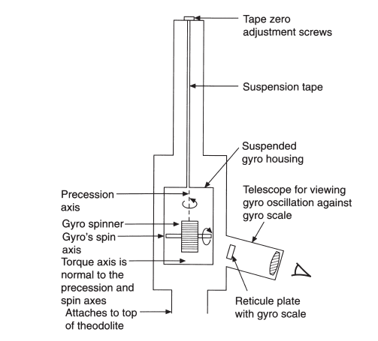
The essential elements of the suspended gyro-theodolite are shown in Figure Suspended gyro attachment

Slide 4
Before the GAK1 can be used, a special mount or bridge must be fixed by the manufacturer to the top of the theodolite.
The gyro attachment fits into the bridge so that three studs on the base of the gyro fit into the three grooves in the bridge with the gyro scale viewed from the same position as the theodolite on face left.
The GAK1 consists of a spinner that is mounted in a mast, which in turn is suspended by a fine wire, or tape, from a fixed point near the top of the gyro frame.
The spinner is simply a cylinder of metal mounted on an axle which, in turn, is held by the mast.
The mast is merely a carriage for the spinner.
The spinner is driven by a small electric motor at a design angular rate of 22000 rpm.
To avoid damage during transit and during running up and slowing down of the spinner, the mast is held against the body of the gyro housing by a clamp at the gyro base.
When the gyro is operating the clamp is released and the mast and spinner as a complete unit hang suspended. This system then oscillates slowly about its vertical axis.
The amount of movement is detected by observing the shadow of a mark in a part of the optical train in the mast.
The shadow is projected onto a ground glass scale that may be read directly.

Slide 5
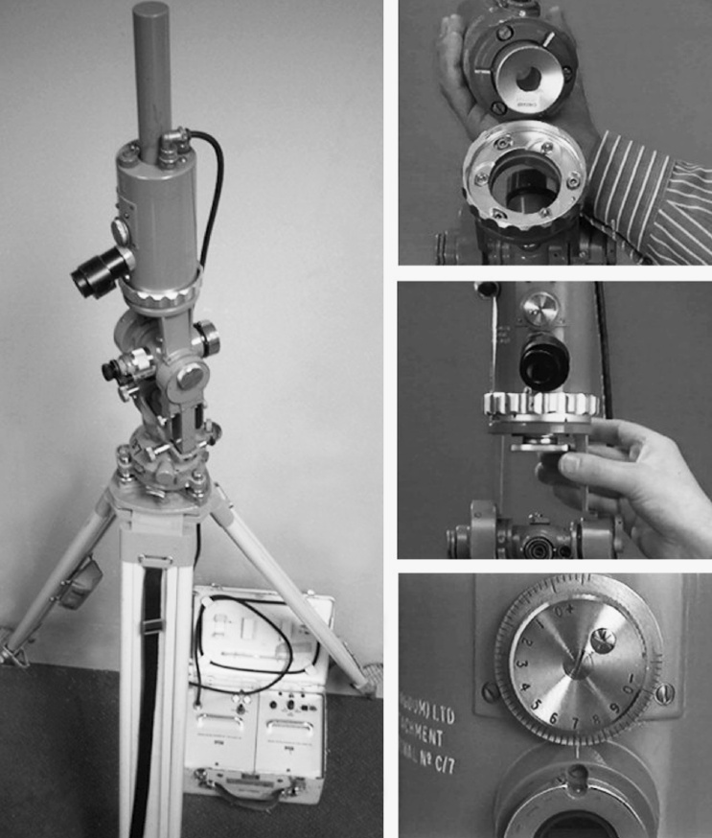
GAK1 mounted on Wild T2

Slide 6
The scale is viewed through a detachable eyepiece. The scale is centred at zero with divisions extending from +15 on the left to −15 on the right .
The position of the moving mark may only be estimated to the nearest 0.1 of a division at best.
Alternatively the scale may be viewed from the side of the eyepiece. This allows an instructor to monitor the observations of a student or two observers to work with the same gyro and observations.
When the observer uses the side viewing eyepiece the image is reversed. The precision of reading may be improved with the aid of a parallel plate micrometer attachment that allows coincidence between the image of the moving mark and a scale division to be achieved.
The position of the moving mark is found as the algebraic sum of the integer number of scale divisions, plus the micrometer scale reading.
The gyro motor is powered through a converter that contains a battery. The gyro may be powered by the converter’s internal battery or by an external battery. The converter ensures that there is a stable power supply even when the external power supply or internal battery voltage starts to run down.

Slide 7
To run up the gyro, first make sure that the gyro is clamped up to ensure that no damage is done to the gyro mechanism during acceleration of the spinner.
Next, see that the external power supply is correctly connected. Turn the switch to ‘run’. The ‘measure’ display turns from green to white and the ‘wait’ display turns from white to red. When the spinner is running at full speed the displays on the converter change and the gyro is ready for use.
Now very carefully unclamp the mast so that the gyro hangs suspended only by the tape. This is a tricky operation requiring a steady controlled hand and a little bit of luck, to get a satisfactory drop without wobble or excessive swing. The clamp should be rotated until it meets the stop.
A red line is now visible on the clamp. Pause for a few seconds to allow any unwanted movement to die down and then lower the clamp. The gyro is now supported only by the tape and is free to oscillate about its own vertical axis.
Observations may now be made of the gyro scale.
If the gyro is badly dropped then there may be an excessive 2 Hz wobble which will make observations difficult and inaccurate. If this happens then clamp up and try again. Alternatively, wait a little while and the wobble will decay exponentially.

Slide 8
Also, with a bad drop, the moving mark may go off the scale; if this happens re-clamp the gyro and try again. Do not allow the moving mark to go off the scale as this may damage the tape, and anyway, no observations can be made.
When observations with the spinning gyro are complete the gyro must be clamped up and the spinner brought to rest.
Basic equations
There are two basic equations that govern the behaviour of the gyrotheodolite. The first is concerned with the motion of the moving mark as it appears on the gyro scale and in particular the midpoint of that motion.
The second is concerned with the determination of north from the observed midpoints of swing of the moving mark on the gyro scale and other terms. The midpoint of motion of the moving shadow mark may be found from the equation of motion of the moving mark. This is an equation of damped harmonic motion:
Me^{−Dt} cos(ω(t − p)) + K − y = 0------------(1)

Slide 9
where: M = magnitude of the oscillation
D = damping coefficient
t = time
ω = frequency of the oscillation
p = time at a ‘positive turning point’, see below
K = midpoint of swing as measured on the scale
y = scale reading of the moving mark
The second equation, or north finding equation, finds the reading on the horizontal circle of the theodolite that is equivalent to north. It relates the K of equation (1), determined when the spinner is spinning and also, separately, when the spinner is not spinning. The equation is:
N = H + sB(1 + C) − sCd + A -------------(2)
where: N = the horizontal circle reading of the theodolite equivalent to north
H = the fixed horizontal circle reading when the theodolite is clamped up ready for observations of the gyro
s = the value of one scale unit in angular measure
B = the centre of swing in scale units when the spinner is spinning
C = the ‘torque ratio constant’

Slide 10
d = the centre of swing in scale units when the spinner is not spinning
A = the additive constant
Like astronomical north, the north determined by a gyro is also defined by gravity and by the Earth’s rotation.

